Slide 1
Final Presentation and Demo
Hardware Implementation and Optimization of GRUs for BCI systems
Lex Berezowski

Slide 2
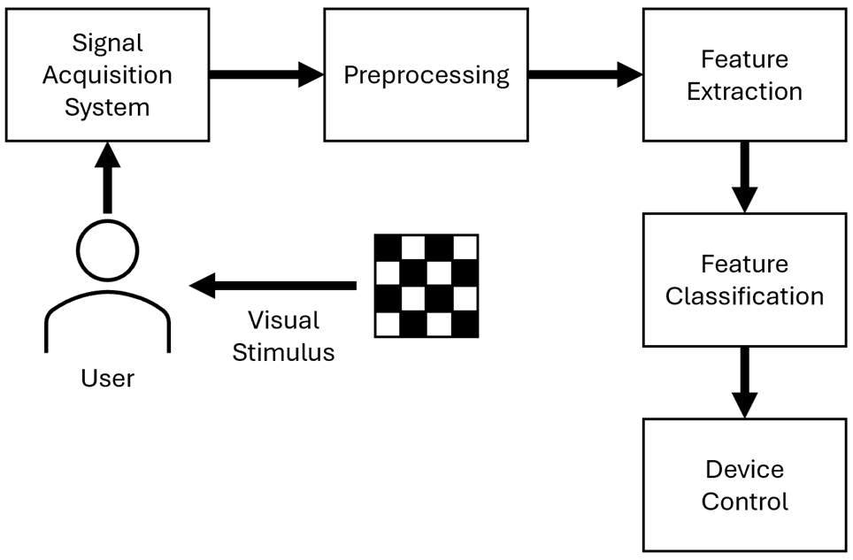
Literature Review – Architecture of a BCI System
L. F. Nicolas-Alonso and J. Gomez-Gil, “Brain Computer Interfaces, a review,” Sensors, vol. 12, no. 2, pp. 1211–1279, Jan. 2012. doi:10.3390/s120201211

Slide 3
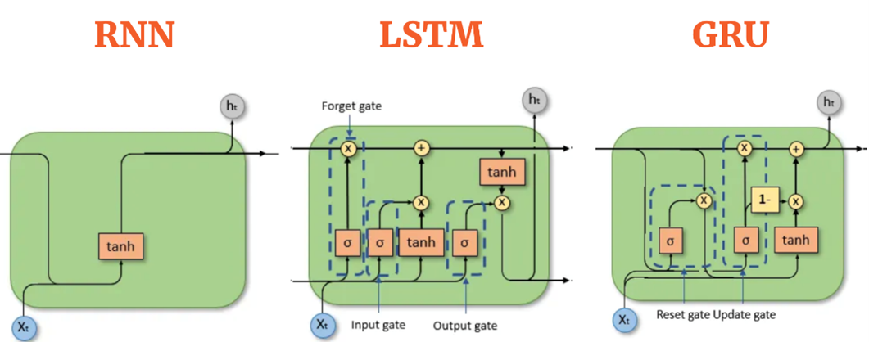
Literature Review – GRU
Stuff
AIML.com, “Sequence models compared: RNNS, lstms, Grus, and Transformers,” AIML.com, https://aiml.com/compare-the-different-sequence-models-rnn-lstm-gru-and-transformers/.

Slide 4
Literature Review – FPGA
Platform | Pros | Cons
CPU | Flexible, can handle diverse computing tasks Widely available and easy to program Mature software ecosystem | High power consumption Not fully optimized for ML operations (matrix additions / multiplications) Lower parallelism
GPU | Optimized for matrix operations High parallelism. Tools like CUDA enable hardware-specific acceleration Well-suited for ML training and inference | Higher power consumption than CPUs in embedded scenarios Memory constraints may require model optimization Bulkier and less portable than low-power solutions.
FPGA | Reconfigurable hardware allows custom accelerators. High parallelism High performance and power efficiency for specific models Can be optimized at the model level. | Long development time High design costs for configuring programmable logic Requires specialized hardware design knowledge
Stuff
F. Pacini, T. Pacini, G. Lai, A. M. Zocco, and L. Fanucci, “Design and evaluation of CPU-, GPU-, and FPGA-based deployment of a CNN for motor imagery classification in brain-computer interfaces,” Electronics, vol. 13, no. 9, p. 1646, Apr. 2024. doi:10.3390/electronics13091646
Avnet Silica, “FPGA vs. GPU vs. CPU – hardware options for AI Applications | Avnet Silica,” FPGA vs. GPU vs. CPU – hardware options for AI applications, https://my.avnet.com/silica/resources/article/fpga-vs-gpu-vs-cpu-hardware-options-for-ai-applications/.
J. Schneider, “FPGA vs. GPU for deep learning applications,” IBM, https://www.ibm.com/think/topics/fpga-vs-gpu.

Slide 5
Literature Review – FPGA
Hardware implementations of GRUs are scarce, with only two documented implementations. Limited implementations probably due to GRUs being new and less used compared to LSTMs
Zaghloul et al. first implemented an FPGA-based GRU, demonstrating equivalent performance to LSTMs across multiple time-series datasets
Rizwan et al. reimplemented GRUs with a focus on detecting breast cancer (multivariate classification)
No prior work has explored GRU hardware optimization or hardware GRUs applied to BCI
K. S. Mohammed Rizwan, S. Nikhil Gowda, S. Yashwanth and K. Anuros Thomas, "Custom Hardware Architecture for FPGA-Based Gated Recurrent Unit," 2025 IEEE 14th International Conference on Communications, Circuits and Systems (ICCCAS), Wuhan, China, 2025, pp. 81-86, doi: 10.1109/ICCCAS65806.2025.11102499.
Z. S. Zaghloul and N. Elsayed, "The FPGA Hardware Implementation of the Gated Recurrent Unit Architecture," SoutheastCon 2021, Atlanta, GA, USA, 2021, pp. 1-5, doi: 10.1109/SoutheastCon45413.2021.9401819.

Slide 6
Literature Review – Hardware Acceleration of GRUs
Optimization | Summary
Shift-And-Add Multiplication | Substitution of conventional multipliers with lower-complexity shift and addition/subtraction operations
Bit Serial Structures | Transformation of parallel arithmetic operations executed in single clock cycles into serial arithmetic operations distributed across multiple clock cycles
Distributed Arithmetic | Replacement of runtime multiplication operations with precomputed partial sum lookup mechanisms
Mixed Precision | Utilization of variable bit-width numerical representations to optimize resource allocation
Alternative Implementation of Sigmoid and Hyperbolic Tangent Functions | Substitution of piecewise linear approximation (PLA) implementations of sigmoid and hyperbolic tangent functions with lookup table (LUT) architectures

Slide 7
Introduction – Research Questions
RQ1: How do FPGA-based feature classification models deployed on the edge compare to MCU-based models?
RQ2: What effect does parallelization have on FPGA-based BCI feature classification models deployed on the edge?
RQ3: What effect does fractional bit width have on FPGA-based BCI feature classification models deployed on the edge?

Slide 8
Experiment Overview
CPU-based GRU Breakdown: Characterise a CPU-based GRU so that the FPGA-based GRU can have a comparison
FPGA-based GRU Design Space Exploration: Explore the GRU design space to determine how different design decisions affect the final GRU
FPGA-based GRU Implementation: Implement GRU on a physical FPGA to determine implementation steps and difficulties

Slide 9
Software Implementation - Methodology
Coded GRU in C++ with same architecture as FPGA GRU
Unravelled code and inlined every method
Converted C++ to assembly
Assumed each instruction is one clock cycle to generalize across over multiple microchips
Counted each type of instruction
Per CPU, calculated how long it would take to run one GRU cycle
Based on time and wattage, calculated joules used per cycle

Slide 10
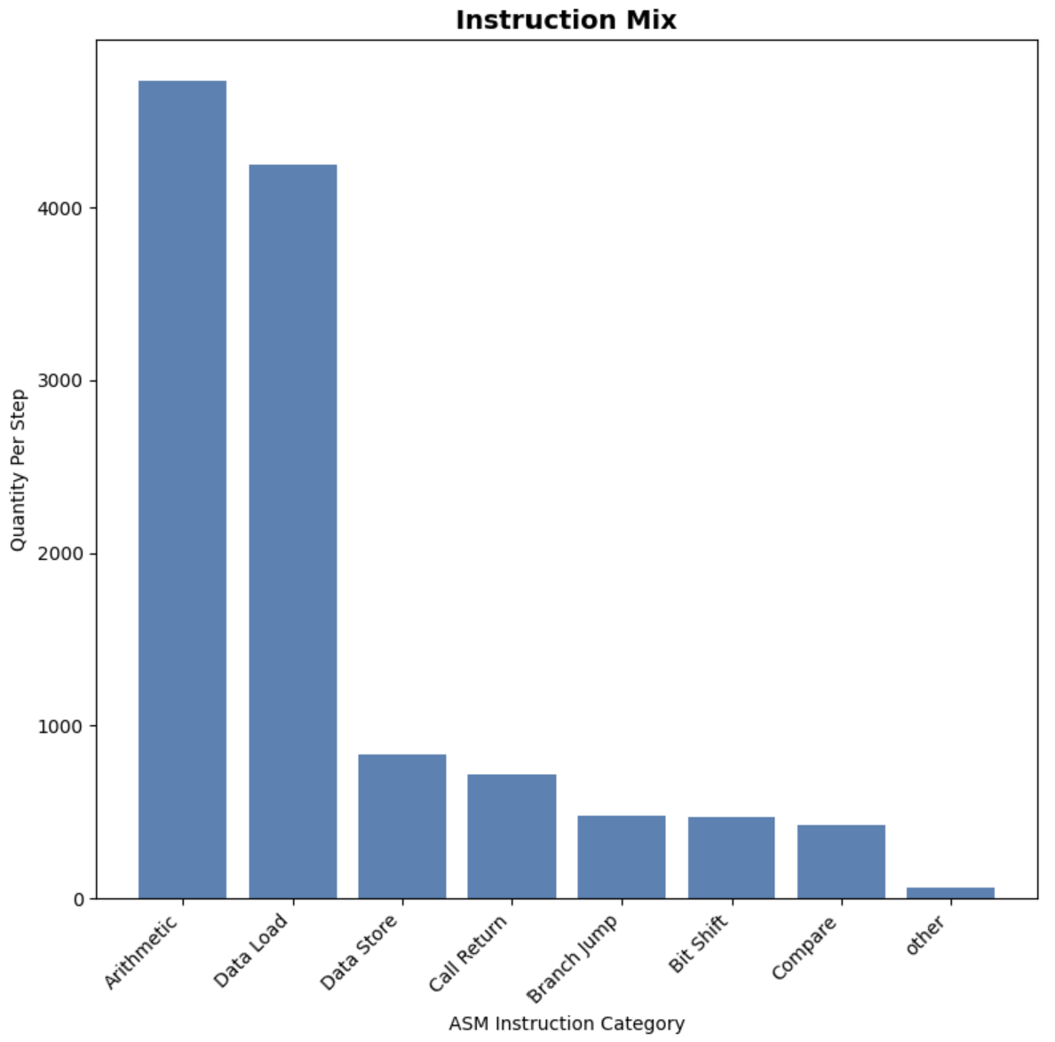
Software Implementation – Results and Discussion
Grouped into type of operations
Loading data and arithmetic operations take a similar amount of instructions
Some data probably needs to be loaded several times as the same input data is used in every GRU equation, increasing data load instructions

Slide 11
Hardware Implementation – Platform Characteristics
CPUs are flexible and easy to program but suffer from high power consumption and limited parallelism, making them poorly suited for the matrix-heavy operations required by machine learning models like GRUs

Slide 12
Hardware Implementation – Platform Characteristics
GPUs are optimized for matrix operations and offer high parallelism, but their high power consumption and bulkier form factor make them less ideal for embedded or edge deployments

Slide 13
Hardware Implementation – Platform Characteristics
FPGAs offer high parallelism and strong performance-per-watt, allowing custom accelerators to be built for specific algorithms at a lower development cost than ASICs

Slide 14
Hardware Implementation – Platform Characteristics
For this project, FPGAs are the ideal platform because their low power consumption and high efficiency make them well-suited for edge deployment close to the user
Further, FPGAs would need to spend less time loading and unloading data as weights and input data can be stored directly on-chip, eliminating the need to repeatedly fetch them from external memory

Slide 15
Hardware Implementation – Input Data
EEG Motor Movement / Imagery Dataset (EEGMMIDB)
1,500+ EEG recordings from 109 volunteers performing MI tasks
Contains 64-channel EEG signals recorded at 160 Hz using the BCI2000 system
A. L. Goldberger, L. A. Amaral, L. Glass, J. M. Hausdorff, P. C.Ivanov, R. G. Mark, J. E. Mietus, G. B. Moody, C.-K. Peng, and H. E.Stanley, “Physiobank, physiotoolkit, and physionet,” Circulation, vol.101, no. 23, Jun 2000.

Slide 16
Hardware Implementation – Input Data
100 deterministic test samples were extracted from the motor imagery tasks to evaluate GRU implementation accuracy
Ground truth outputs calculated using 32-bit floating-point arithmetic serving as the accuracy baseline for evaluating fixed-point hardware implementations.

Slide 17
Hardware Implementation – Methodology
Controlled by an FSM that goes through each of the four GRU equations: reset gate, update gate, new gate, and hidden state
Each output of each equation can be computed independently, thus each gate equation model outputs one equation output
Multiple instances spatially-multiplex calculations
FSM time-multiplexes calculations
GRU
Reset Gate
Reset Gate
Update Gate
Inputs
Reset Gate
Reset Gate
Hidden State
Reset Gate
Reset Gate
Reset Gate
Reset Gate
Reset Gate
New Gate

Slide 18
Hardware Implementation – Design Space
Explored design space by synthesizing and implementing each design via Xilinx Vivado and getting metrics:
Vivado 2024.1
Selected the biggest FPGA board available for testing
Used Arty-100T for metric calculation

Slide 19
Hardware Implementation – Design Space
Metrics:
WNS (ns): Worst Negative Slack
LUTs: Number of Look Up Tables
Registers: Number of Registers
Cycles: FPGA Cycles to Complete one GRU Step
MAE: Mean Absolute Error
RMSE: Root Mean Square Error
Average Utilization: Average Hardware Utilization Percent across hardware metrics
Clock Period Utilization: Percent of each clock cycle used
Cycle Utilization: Percent of cycles in a sampling period used
Time Utilization: Clock Period Utilization * Cycle Utilization

Slide 20
Hardware Implementation – Design Space
Controlled Design Space:
clock_period_range = 100 MHz
int_width_range = 10
d = 64
h = 16
Independent Design Space:
num_parallel_range = {1, 2, 4, 8, 16}: How much parallelization is used within the GRU
frac_width_range = 1-16, 1 step: How many fractional bits are used

Slide 21
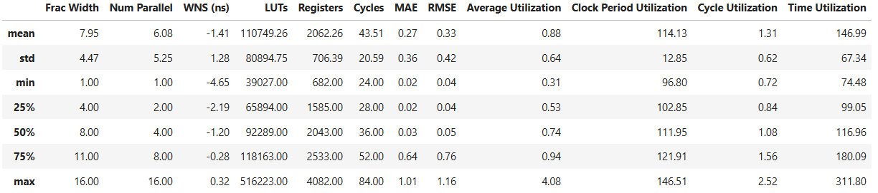
Hardware Implementation – Analysis and Discussion

Slide 22
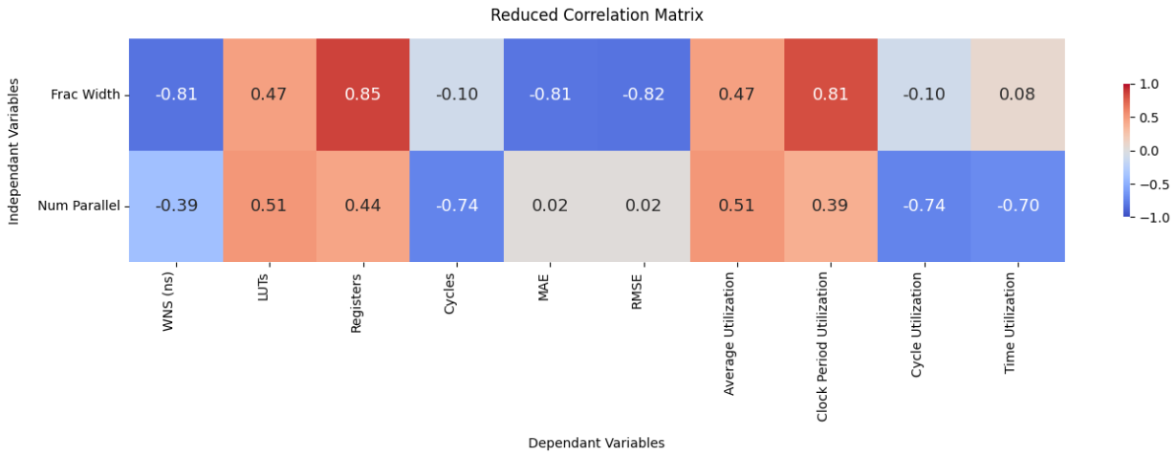
Hardware Implementation – Analysis and Discussion

Slide 23
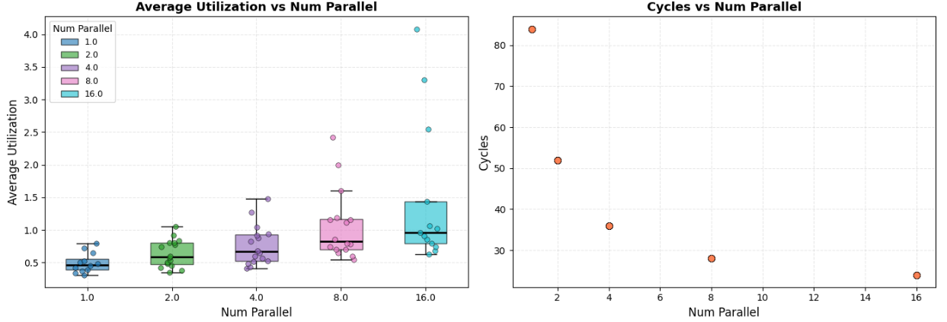
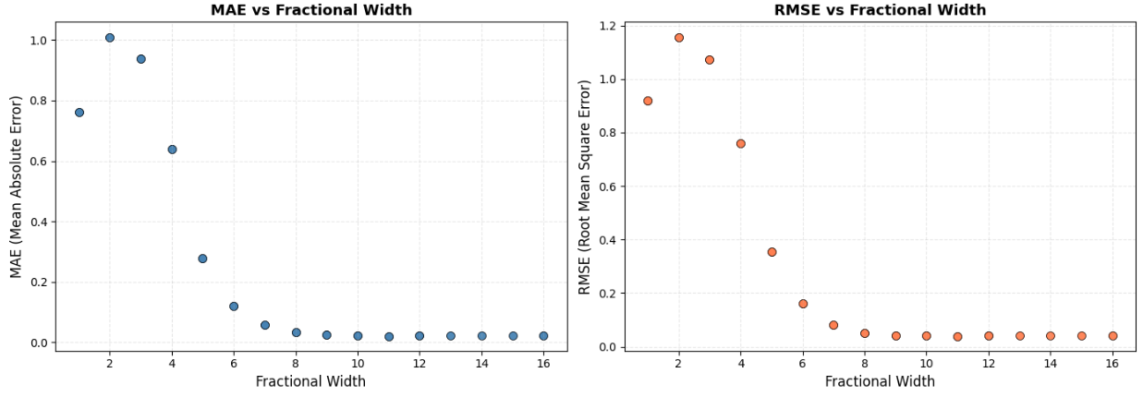
Title
Stuff

Slide 24
System Integration - Methodology
Was originally going to physically implement an MCU and a GRU and compare the two
Unable to implement as I didn’t have enough time to figure out a communication protocol that could do 64x 16-bit numbers at 40KHz (Utah Array Frequency)
Instead compared a GRU implementation against a similar architecture MCU implementation
Maximum Step Frequency (Hz) = Operating Frequency / Instructions
Energy per Step (J) = (Instructions / Operating Frequency) * Operating Wattage

Slide 25
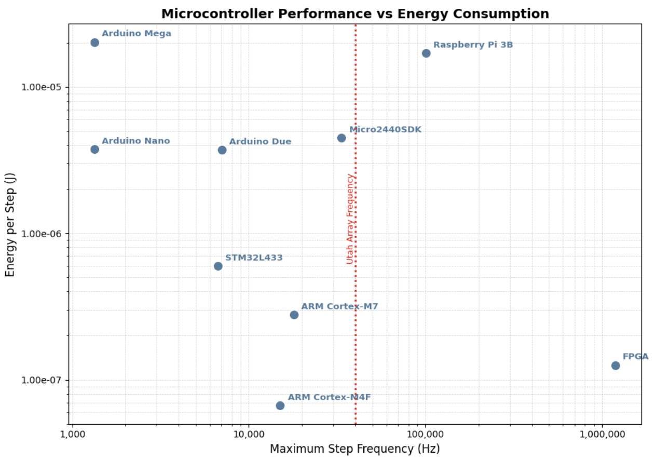
System Integration – Analysis and Discussion
Compared my implementation to MCUs used in current edge BCI deployments
X Axis: Maximum frequency GRU steps can run, bigger is better
Y Axis: Energy used per GRU step, smaller is better

Slide 26
Answer to RQ1
How do FPGA-based feature classification models deployed on the edge compare to MCU-based models?
Generally more power efficient
Allows easier edge deployment
Longer lasting between charges
Will probably generate less heat output than MCU’s due to less power used
Always able to operate at a higher frequency
Important for being able to run at the edge during deployment
Probably holds true when scaling from motor imagery inputs (64 channels) to full Utah Array inputs (1024 channels)
Much harder to program FPGA compared to MCU

Slide 27
Answer to RQ2
What effect does parallelization have on FPGA-based BCI feature classification models deployed on the edge?
Higher parallelization results in less clock cycles used but more hardware usage
As expected, no change to accuracy
Further hardware optimizations that were explored but not implemented could help offset hardware usage
Super high parallelization not needed because of how fast the GRU runs compared to the incoming sample frequency (100MHz vs 40KHz)
Low parallelization allows hardware reuse, which may become more important if going from 64 channels to 1024 channels

Slide 28
Answer to RQ3
What effect does fractional bit width have on FPGA-based BCI feature classification models deployed on the edge?
Higher fractional bits is more accurate, but consumes more hardware resources
Not much benefit after 7 bits of fractional bits, none after 9
Affects clock period utilization but not cycle utilization.
In retrospect, this is not an FPGA-specific metric, however it is specific to the GRU. Could have done these calculations in software and come to the same findings much faster.

Slide 29
Key Insights
FPGAs seem to be better than MCUs for GRU deployments of high-frequency BCI systems
Further optimizations should focus on reducing hardware area and power usage rather than speeding up the algorithm, as this would be more useful for edge BCI systems
7 fractional bits seems to be an optimal amount of fractional bits

Slide 30
Limitations and Reflection
Start with target BCI signal acquisition system and what the desired metrics are in mind
Do more research on which machine learning architecture to explore
If choosing a more used machine learning architecture, find the current leading MCU deployment and characterize it to figure out what problems it has. Then use FPGA to solve said problems if that makes sense.
Accuracy calculations should have been software based, not hardware based
Background research would go more in depth on design details (for each optimization, how is it actually done and how much would it theoretically improve each metric) so that the most optimal optimization is chosen

Slide 31
Demonstration
CPU Implementation
Simulation code

